Slide 1
1. Classification of groundwater level data using SOM to develop ANN-based forecasting model (2012, V.Nourani)
2. Clustering fluctuation patterns of groundwater levels in Tokyo caused by he great east Japan earthquake using self-organizing maps (2017, Akira KAWAMURA)
정지호

Slide 2
Classification of groundwater level data using SOM to develop ANN-based forecasting model (2012, V.Nourani)

Slide 3
Classification of groundwater level data using SOM to develop ANN-based forecasting model (2012, V.Nourani)
Modeling
1) Data-based models
2) Physical-based models
3) Conceptual models
- Conceptual and physical-based models are used primarily to understand the various hydraulic
parameters and physical processes that occur in groundwater systems
- However, they have several problems, such as the need for a large number of hydraulic data for use,
or an in-depth understanding of the physical process.
- Data-based methods that overcome the limitations of the physical-based models are widely used in
many fields of science and engineering

Slide 4
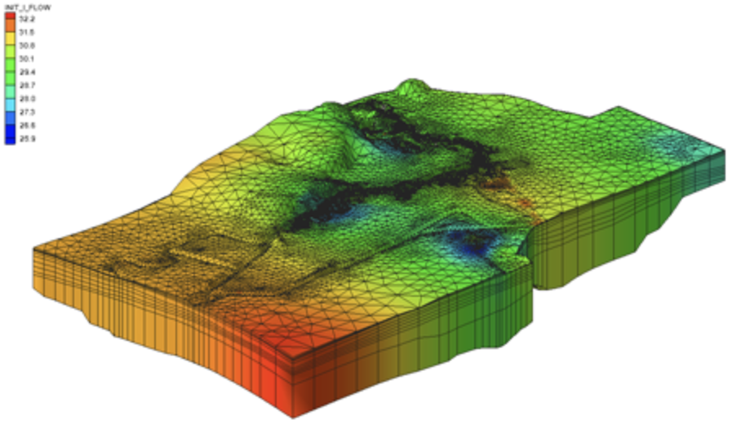
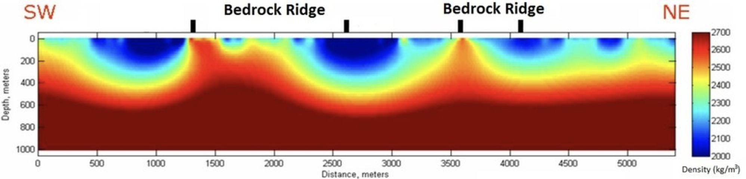
Classification of groundwater level data using SOM to develop ANN-based forecasting model (2012, V.Nourani)
Physical-based modeling
- The figure on the right is an example of
modeling (2D, 3D) used in geology

Slide 5
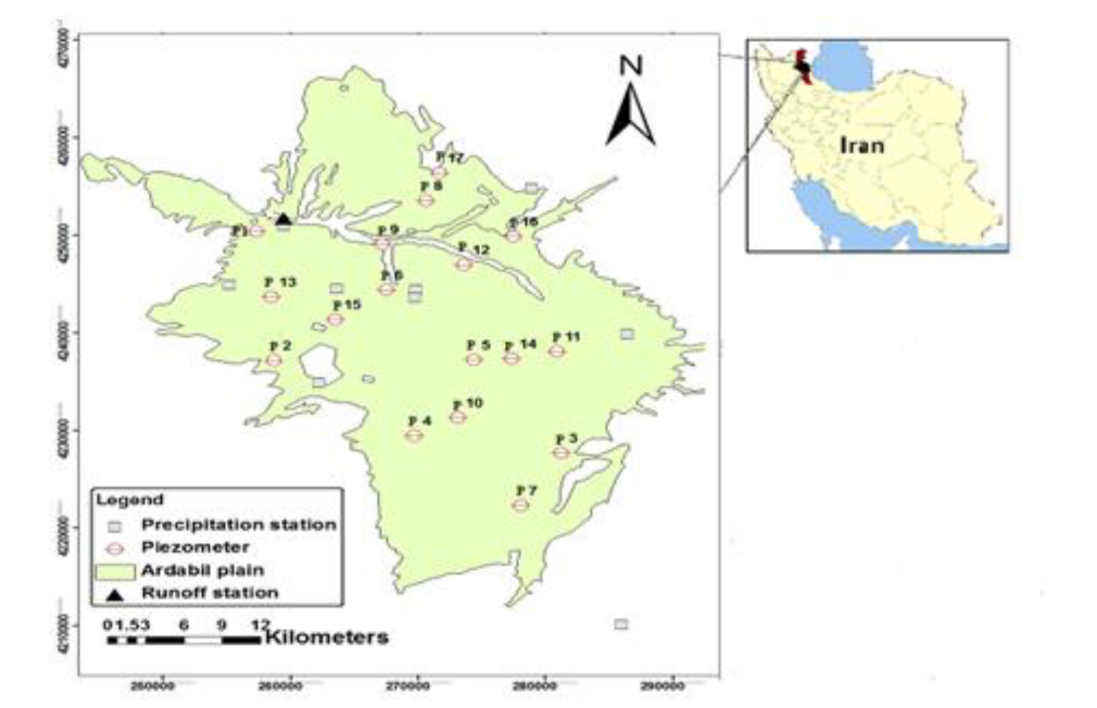
Classification of groundwater level data using SOM to develop ANN-based forecasting model (2012, V.Nourani)
The purpose of this paper:
- Propose a mathematical model for predicting
groundwater level in Ardabil area located in the
north-western Iran

Slide 6
Classification of groundwater level data using SOM to develop ANN-based forecasting model (2012, V.Nourani)
◦ To achieve the goal, follow the three steps described below:
Homogenous monitoring piezometers were classified by applying groundwater level data and UTM (Universal Transverse Mercator) data to Self-Organizing Map (SOM)
Representative piezometers of each cluster were selected using statistical techniques and then three-layer feedforward ANN models were used to calibrate the model by training precipitation data related to representative groundwater fluctuations
Finally, based on the proposed model, predicted levels of representative piezometers corresponding to each region were simulated

Slide 7
Classification of groundwater level data using SOM to develop ANN-based forecasting model (2012, V.Nourani)
Cluster analysis
- A statistical method that divides samples into similar classes to produce an overview of the data set
- An important part of the cluster analysis is to group the entire data into several subgroups
- The clustering technique identifies the structure of an unlabeled data set so that the dissimilarity
within the group is minimized and the dissimilarity between the groups is maximized
- There are various methods for clustering data. Recently, there is a growing demand for such
clustering techniques in the field of groundwater management

Slide 8
Classification of groundwater level data using SOM to develop ANN-based forecasting model (2012, V.Nourani)
SOM, an ANN-based clustering method, has recently been used in several ways with the advantages of accessibility and visualization
1) Peeters et al. Compared the performance of the GEO3DSOM and standard SOM in analyzing an
artificial data set and a hydro-chemical data set
2) Chen et al. used the combination of the back-propagation network (BPN) and the self-organizing
map (SOM) for forecasting the groundwater level data in southern Taiwan
3) Kalteh et al. prepared a review paper to discuss the analysis, modeling and application of SOM
approach in water resources , another review of SOM applications in meteorology and oceanography
is reported by Liu and Weisberg as well

Slide 9
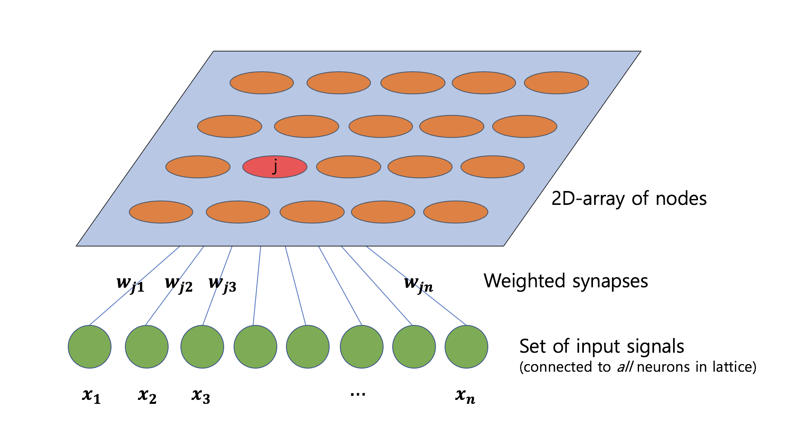
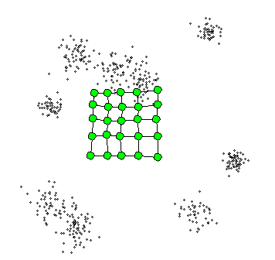
Classification of groundwater level data using SOM to develop ANN-based forecasting model (2012, V.Nourani)
Self-Organizing Map
- The self-organizing map (SOM) is an effective software tool for the visualization of high-dimensional data
- It implements an orderly mapping of a high-dimensional distribution onto a regular low-dimensional grid
- Thereby it is able to convert complex, nonlinear statistical relationships between high-dimensional data items into simple geometric relationships on a low-dimensional display while preserving the topology structure of the data

Slide 10
Classification of groundwater level data using SOM to develop ANN-based forecasting model (2012, V.Nourani)
The purpose of this paper is to predict the groundwater level fluctuation patterns of Ardabil Plain (located in the north-western Iran) after one month through the SOM-ANN model
1) First step, measured data from 17 piezometers were classified into several classes by 2D_SOM
2) Second step, 1D-SOM was applied to classify the specific number of piezometer stations determined
in the first step, and the representative GWL pattern of each cluster was determined by applying the
euclidean distance criterion.
3) Third step, For each representative pattern determined in the second step, FFNN model was applied to
predict groundwater level

Slide 11
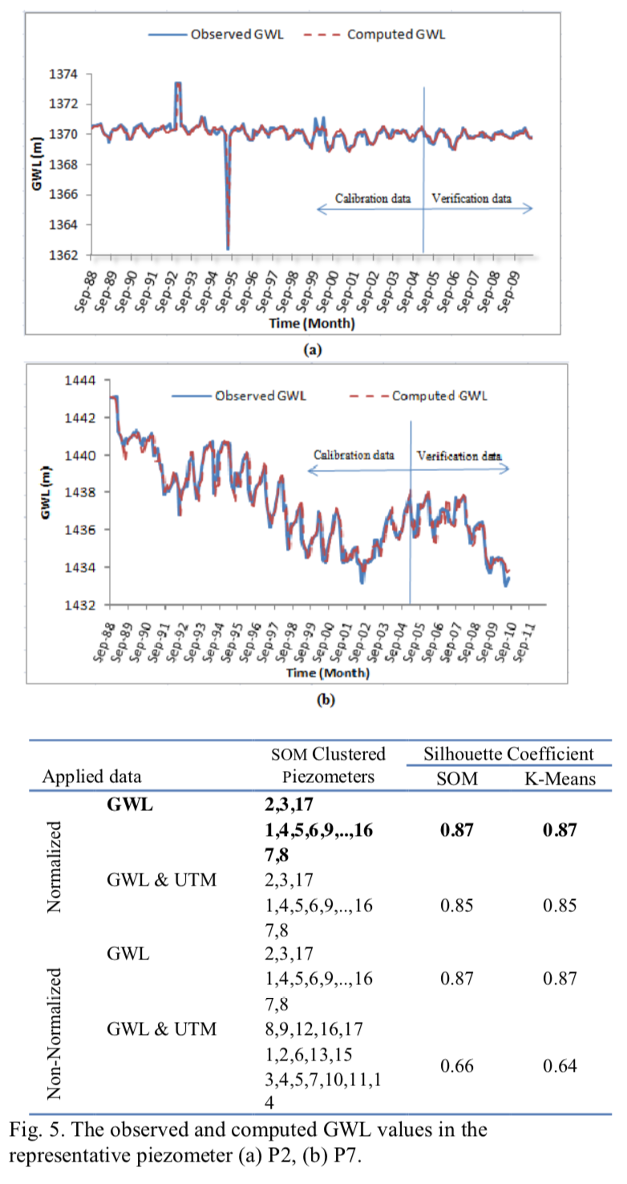
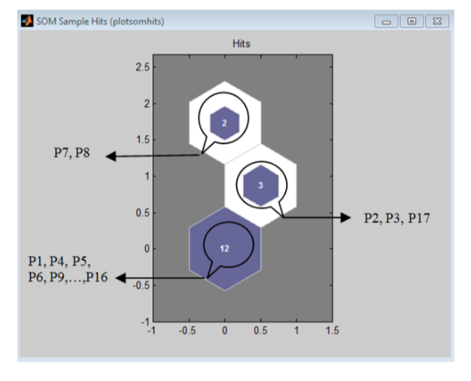
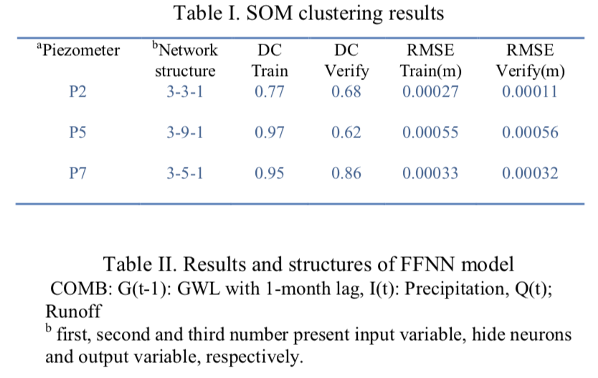
Classification of groundwater level data using SOM to develop ANN-based forecasting model (2012, V.Nourani)
Results

Slide 12
Clustering fluctuation patterns of groundwater levels in Tokyo caused by he great east Japan earthquake using self-organizing maps (2017, Akira KAWAMURA)

Slide 13
Clustering fluctuation patterns of groundwater levels in Tokyo caused by he great east Japan earthquake using self-organizing maps (2017, Akira KAWAMURA)
In this study, groundwater level fluctuation patterns measured in several monitoring wells were classified by self-organizing map when the Great East Japan Earthquake occurred on March 11, 2011, the most powerful earthquake in Japan
The effects of Great East Japan Earthquake caused ground liquefaction and changes in groundwater level fluctuation patterns
The evaluation of the sudden change in the groundwater level after the earthquake is effective in predicting the impact on the hydrological cycle and may be useful in future studies
SOM is sometimes used in hydrology, meteorology, etc., but has never been used to classify groundwater characteristics. In this paper, SOM was applied to the time-series data collected from the groundwater monitoring system at the time of the East Japan Earthquake

Slide 14
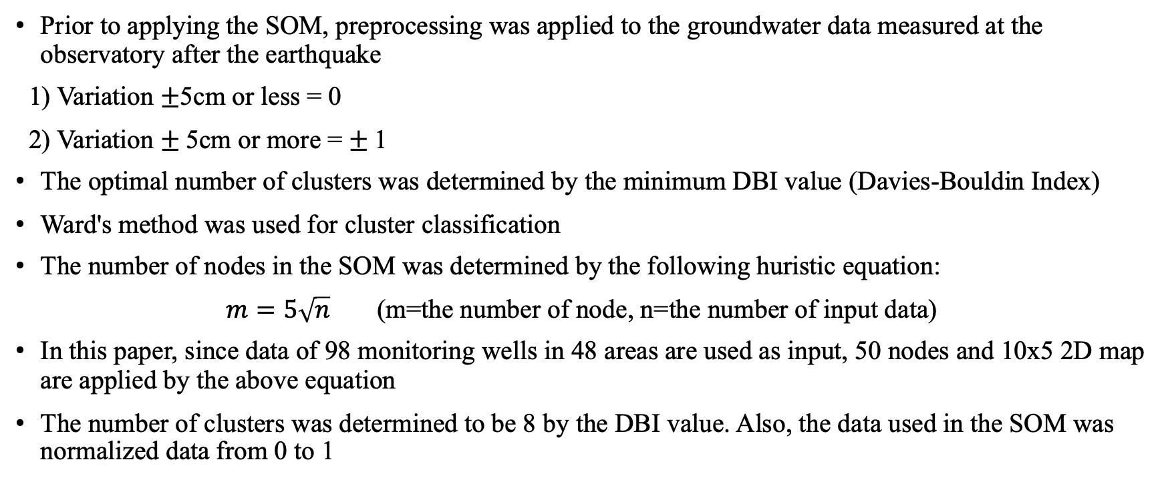
Clustering fluctuation patterns of groundwater levels in Tokyo caused by he great east Japan earthquake using self-organizing maps (2017, Akira KAWAMURA)
Prior to applying the SOM, preprocessing was applied to the groundwater data measured at the observatory after the earthquake
1) Variation $±$5cm or less = 0
2) Variation $±$5cm or more = $±$1
The optimal number of clusters was determined by the minimum DBI value (Davies-Bouldin Index)
Ward's method was used for cluster classification
The number of nodes in the SOM was determined by the following huristic equation:
$m=5\sqrt{n}$(m=the number of node, n=the number of input data)
In this paper, since data of 98 monitoring wells in 48 areas are used as input, 50 nodes and 10x5 2D map are applied by the above equation
The number of clusters was determined to be 8 by the DBI value. Also, the data used in the SOM was normalized data from 0 to 1

Slide 15
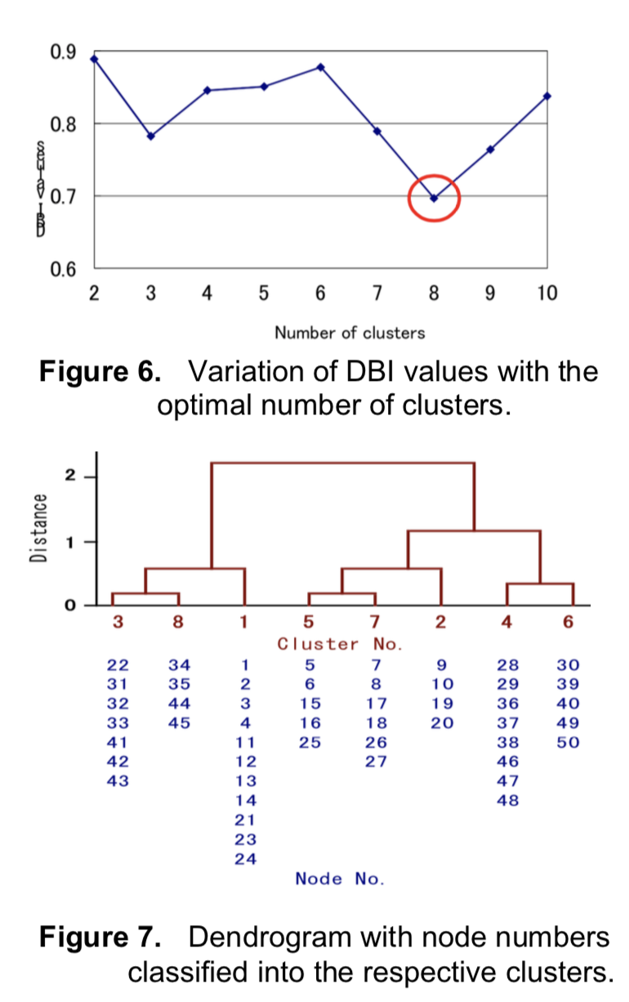
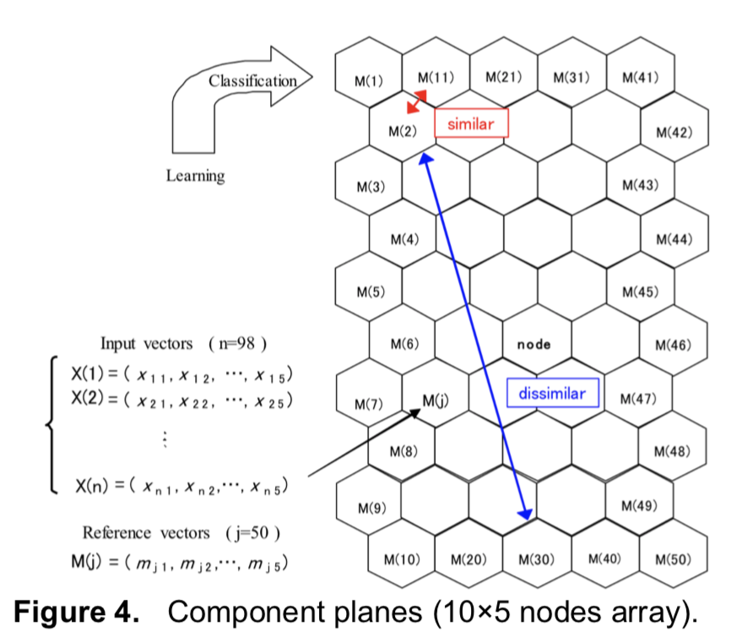
Clustering fluctuation patterns of groundwater levels in Tokyo caused by he great east Japan earthquake using self-organizing maps (2017, Akira KAWAMURA)

Slide 16
Clustering fluctuation patterns of groundwater levels in Tokyo caused by he great east Japan earthquake using self-organizing maps (2017, Akira KAWAMURA)
Pattern classification of water level fluctuation using SOM
- Cluster 1: it can be seen that the groundwater level decreased significantly just after the earthquake,
but by the following day, it had returned to the level just before the earthquake. It continued to
increase until March 14 and remained at that level until March 31
- Cluster 2: it can be seen that the groundwater level decreased significantly just after the earthquake,
and it remained at that level until the following day. By March 14, it had returned to the level
slightly lower than just before the earthquake, and it kept recovering until March 31
- Cluster 3: it can be seen that the groundwater level decreased the most in all the clusters at 16:00,
March 11. It increased on the following day to a higher level than just before the earthquake,
and it remained at that level until March 31
- Cluster 4: it can be seen that the groundwater level slightly increased or showed no significantly
change just after the earthquake and from then on

Slide 17
Clustering fluctuation patterns of groundwater levels in Tokyo caused by he great east Japan earthquake using self-organizing maps (2017, Akira KAWAMURA)
Pattern classification of water level fluctuation using SOM
- Cluster 5: it can be seen that the groundwater level decreased significantly just after the earthquake,
and it had returned to the level just before the earthquake by the following day. It remained at this
level until March 14, then continued increasing again until March 31
- Cluster 6: no increase or drastic changes were observed just after the earthquake, and the groundwater
level decreased on the following day to the level lower than just before the earthquake. It had returned
to the level equivalent to just before the earthquake by March 14, and had fallen again by March 31
- Cluster 7: the groundwater level shows a relatively significant decrease just after the earthquake, and
it remained at that level until the following day. It returned to the level just before the earthquake on
March 14, and continued increasing until March 31
- Cluster 8: it can be seen that following the large decrease in groundwater level just after the
earthquake, the level suddenly increase. It decreased again to the level just before the earthquake on
March 14, and continued increasing until March 31

Slide 18
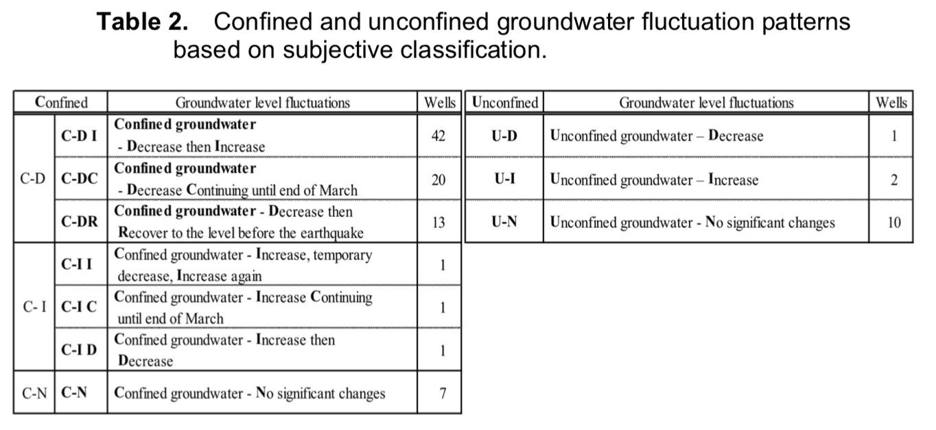
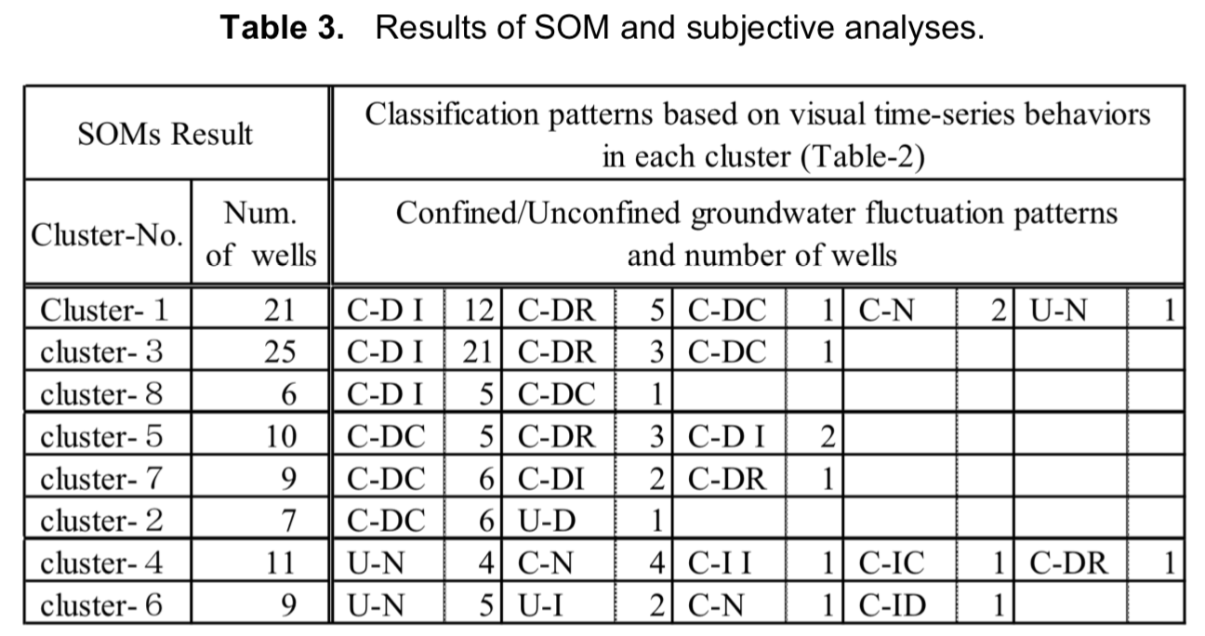
Clustering fluctuation patterns of groundwater levels in Tokyo caused by he great east Japan earthquake using self-organizing maps (2017, Akira KAWAMURA)

Slide 19
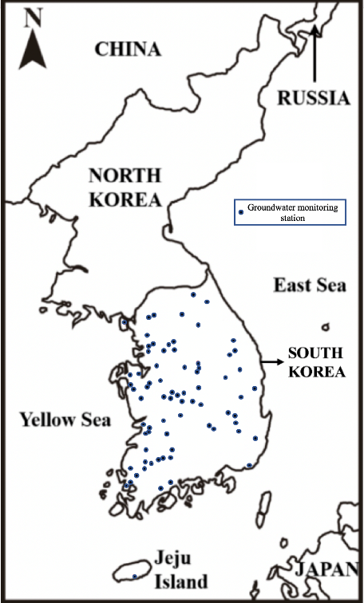
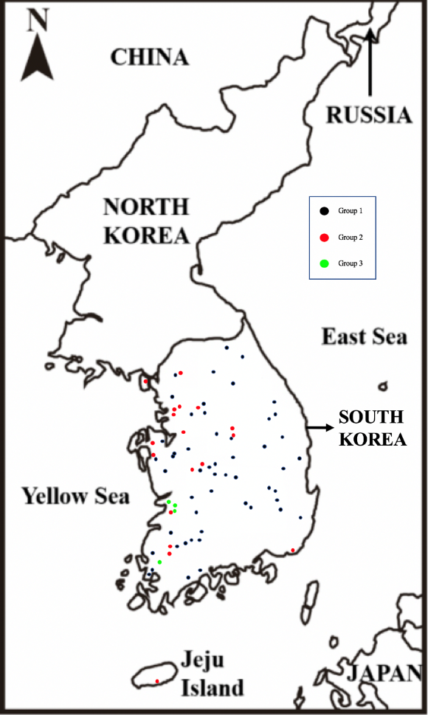
Classification based on groundwater fluctuation pattern
The number of observations: The groundwater level fluctuation and the precipitation data of 74 location are applied in the present study, which are acquired form the National Groundwater Information Center and the Korea Meteorological Administration
Period: Groundwater level and precipitation data from year of 2004 to 2014 are applied, except for two areas including a lot of measurement errors and missing intervals

Slide 20
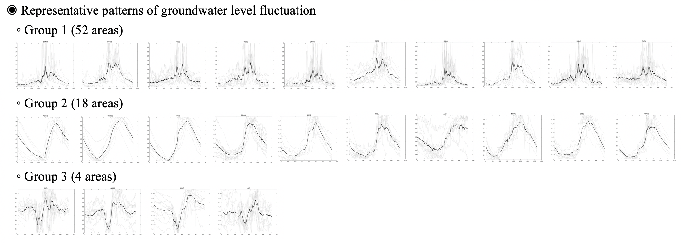
Classification based on groundwater fluctuation pattern

Slide 21
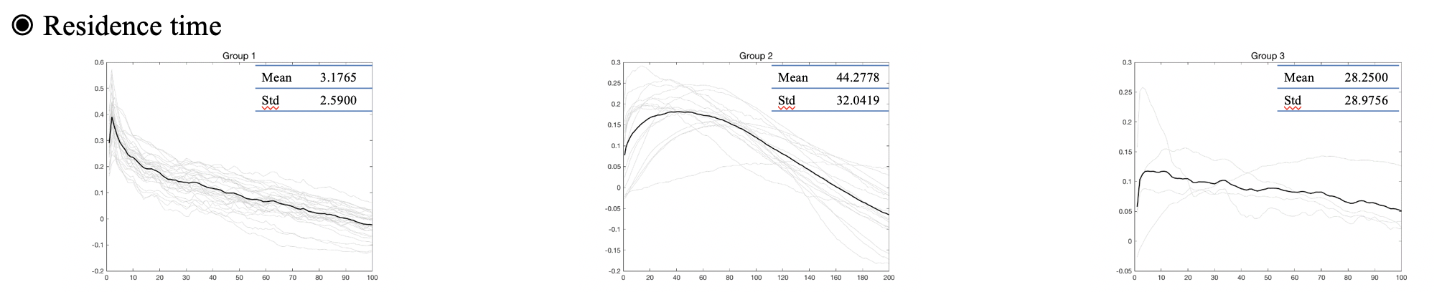
Classification based on groundwater fluctuation pattern

Slide 22
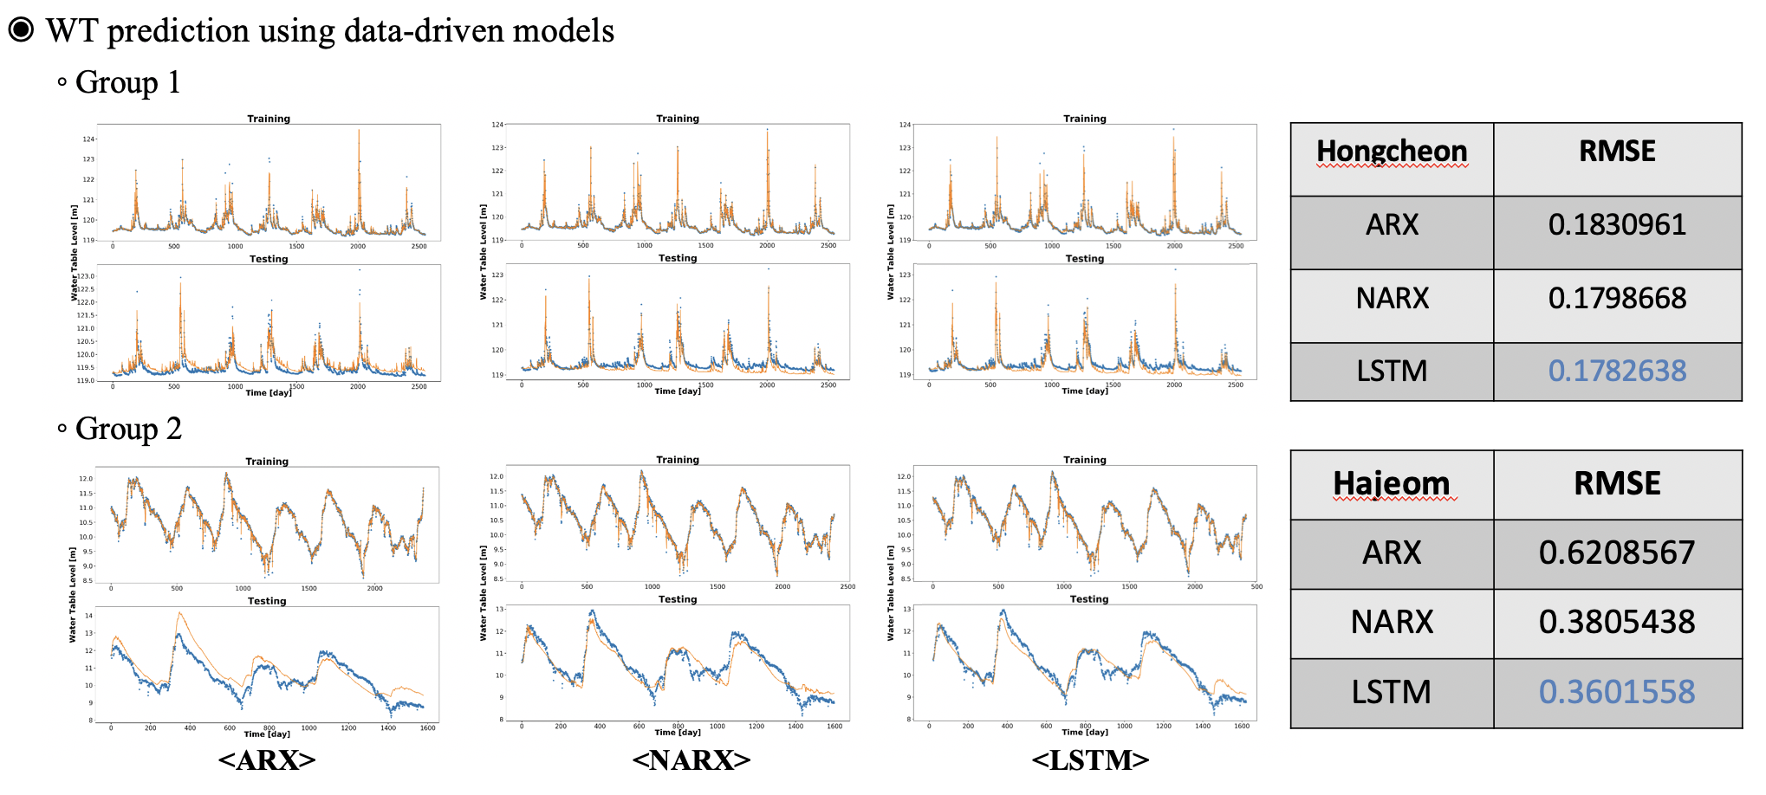
Classification based on groundwater fluctuation pattern

